Slide 1
Shape approximation & construction INside tolerance Volume
Sagar Chordia
Guide: Pierre Alliez

Slide 2
Approximation Problem
Fattening(?) surface by epsilon amount, we get pair of new surfaces sandwiching original surface between them. These new surfaces called as tolerance volume.
To approximate shape in this tolerance volume with minimum number of primitives

Slide 3
Outline
Goals and Motivations
Notions
Related Work
Convex 2d case
Non convex 2d case
Any 2d topology
Convex 3d case
Proposal
2D
3D direction
Summary

Slide 4
Goals and Motivation

Slide 5
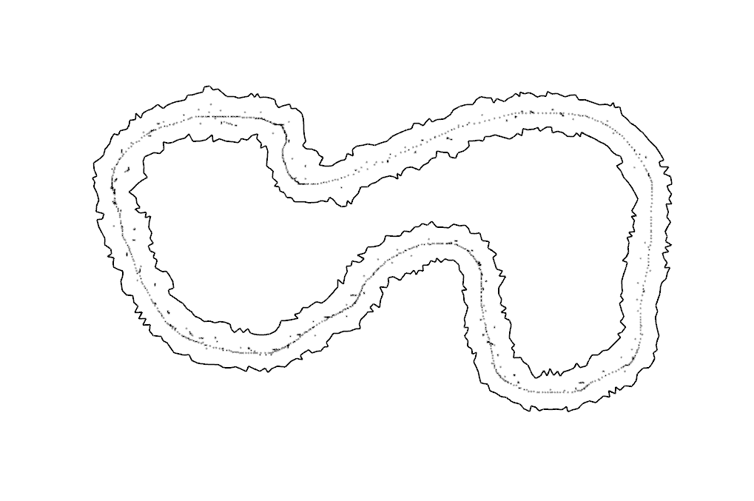
Goals and Motivation
Input:
Reconstruction:
Point sets or soup of segment/ triangles.
Approximation:
surface geometry
Parameter: Tolerance (ϵ - shell)

Slide 6
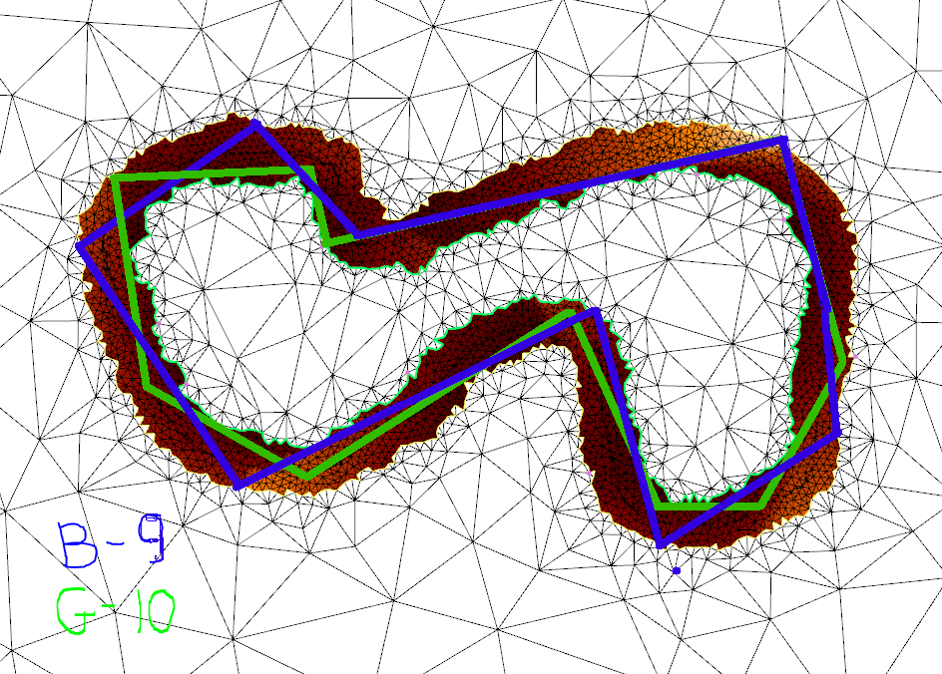
Goals and Motivation
Output:
Polygonal curve/ Polyhedron inside tolerance volume.
Properties:
With minimum number of primitives.
Covering shape only once.
Free of self-intersection.

Slide 7
Sample points with tolerance volume around it
Input : Outer boundary(P) with one hole(Q) (Tolerance Volume)
Output: Simple Polygonal curve(K)

Slide 8
Preprocessing of vertices of triangulation inside Tolerance Volume

Slide 9
Notions/ keywords

Slide 10
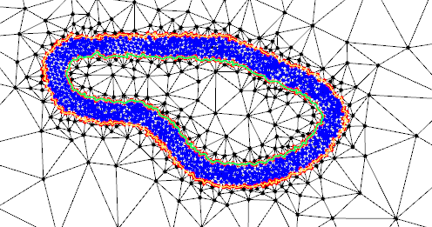
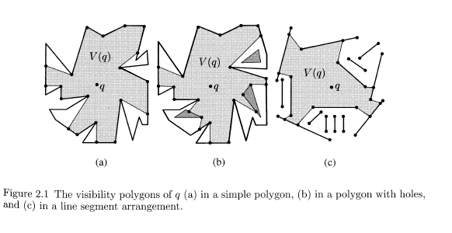
Notions
Environment/ Free sace: region inside tolerance volume.
Visibility polygon: set of points in environment visible from a point

Slide 11
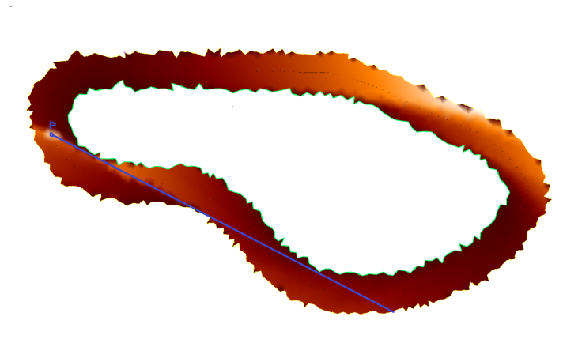
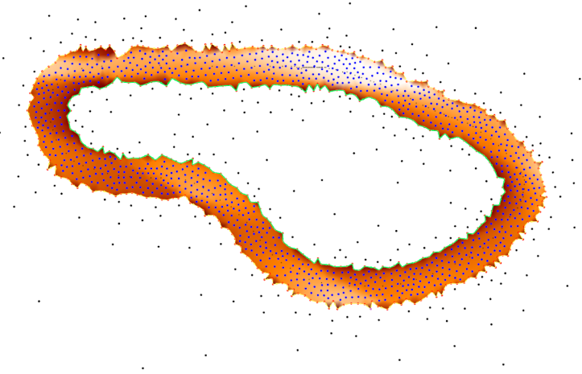
Notions
Visibility Graph : graph of which vertex sees which one.
Visibility Length : distance of farthest point visible from a point.
Visibility area: area of visibility polygon of a vertex

Slide 12
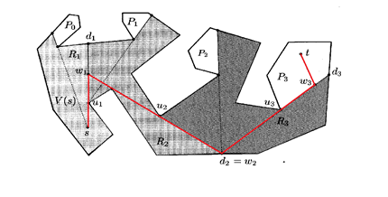
Notions
Minimum Link Path :
path in the environment between 2 points having minimum no. of turns.
O(n) algorithm by S.Ghosh using weak and strong visibility.
Path between s and t having 4 turns

Slide 13
Blue polyline – sub-optimal reconstruction
Green polyline – some construction

Slide 14
Related work

Slide 15
Related Work
Single hole case:
Minimum nested Polygon(Q C K C P)
Convex case: Hole and outer boundary both
O(n log k) algorithm by Aggarwal. Also by Ghosh. k – no of edges in constructed polygon.
Non convex case:
O(n) algorithm by Ghosh and Maheshwari
Multiple holes:
Separating subdivision
NP – complete
(O(n log n) algo. with atmost 9(k-1) edges more than optimal no. of edges) by Mitchell and Suri

Slide 16
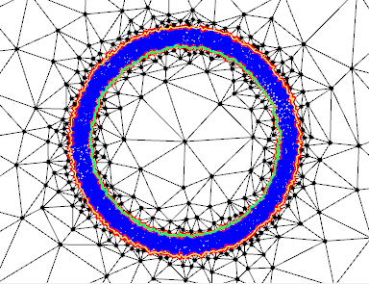
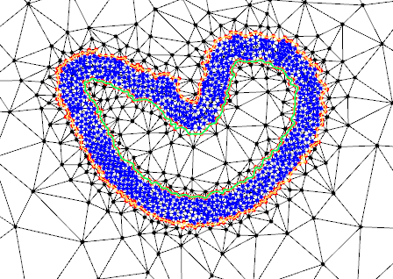
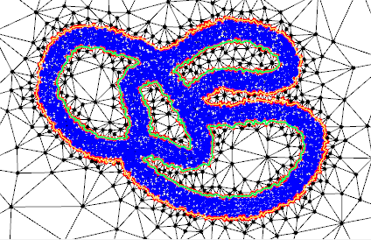
Related Work – 2d
Single hole case:
Convex case:
Non convex case:
Multiple holes:
Separating subdivision

Slide 17
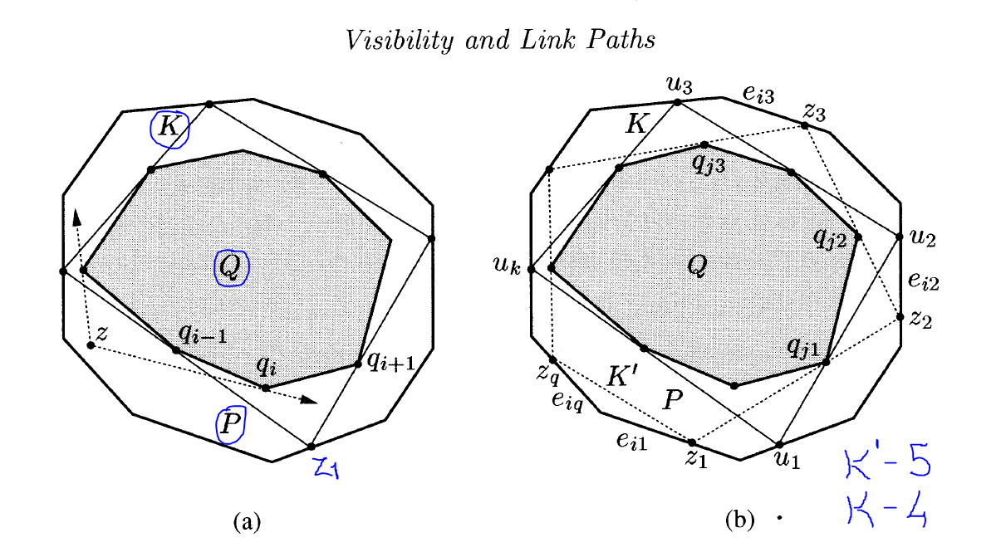
Convex single hole
O(n log k) algorithm by Aggarwal. Also by Ghosh.
k – no of edges in constructed polygon.
Image from [Ghosh]
Seed point, z1 ϵ bnd(P)
Draw left tangent from z1 to bnd(Q), extend it to meet bnd(P), and recurse.
Atmost one edge greater than optimal.
Seed point is found by solving projection functions

Slide 18
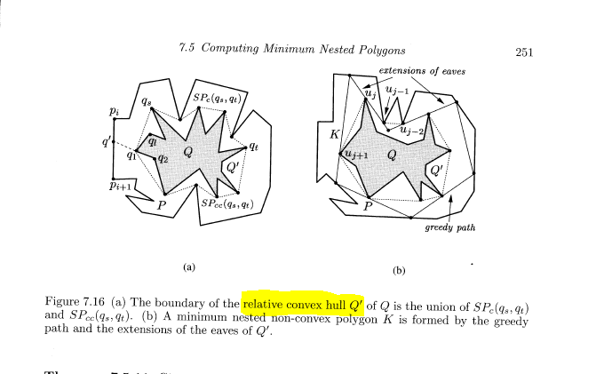
Non-convex single hole
O(n) algorithm by Ghosh and Maheshwari
N- no of edges of boundaries
Find minimum perimeter polygon of Q.(since convex hull intersects outer boundary)
Find eaves
Greedy construction of polyline between these eaves.

Slide 19
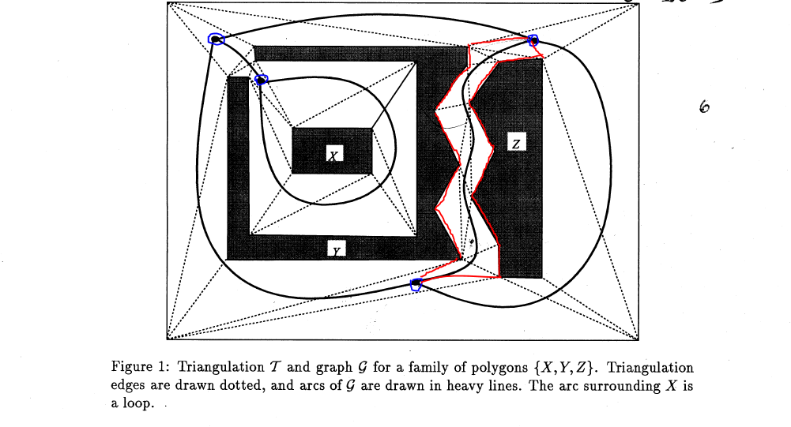
Multiple holes
NP - Complete
(O(n log n) sub optimal algo. with atmost 9(k-1) edges more than optimal no. of edges) by Mitchell and Suri
Find hubs (points where medial axis split) using dual graph of triangulation.
Find minimum link path between 2 hubs through each moat.

Slide 20
Related work - 3d
Convex Polyhedra
NP - complete
Sub-optimal greedy algorithm, with O(log n) more edges than optimal solution
Candidate planes for faces of inner polyhedra and the plane is extended till it cuts outer polyhedra
Non-convex polyhedra
Nothing!!!

Slide 21
Visibility Approach

Slide 22
Approach – 2d
Rationale
Assumption: The length of inferred shape,(sum of all edge lengths) is almost constant value. Equal to perimeter of tolerance volume as ε tends to 0 i.e. under contraction of tolerance volume.
So,
minimum no. of primitives =>
length of each edge in constructed polygon should be maximized.

Slide 23
algorithm
Tolerance volume is discretized into finite number of vertices by
Delaunay refinement of mesh.
Pre compute visibility_length for each vertex, i.e. find farthest point visible from it in counter clockwise sense.(half space notion).
Only boundary of visibility polygon needs to be checked for computing visibility length.
Complexity:
O(n log(n) ) computing visibility polygon.
O(n) - to find visibility_length
O(n) – to find area of visibility polygon
O(n^2 * log n ) for total precomputation

Slide 24
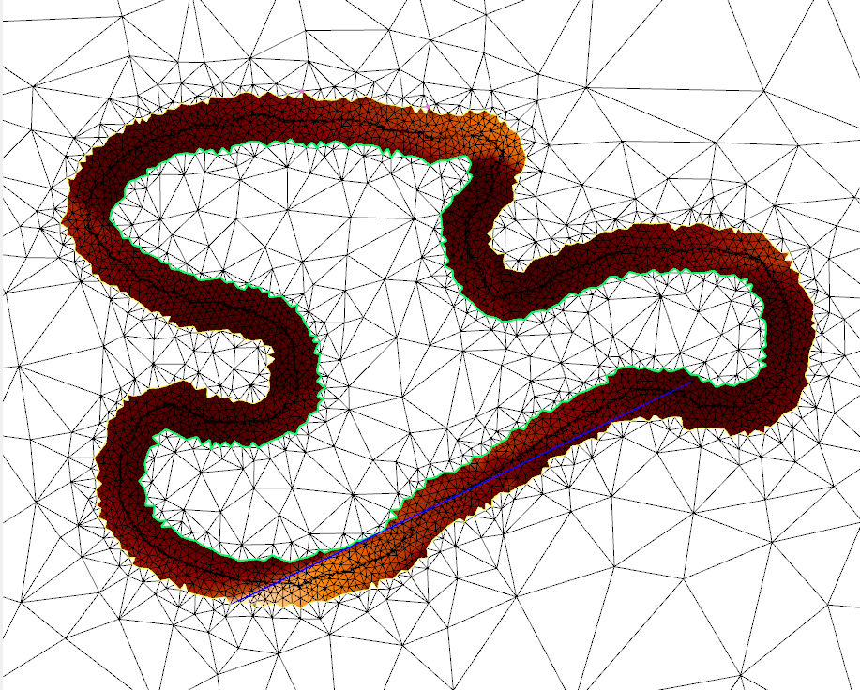

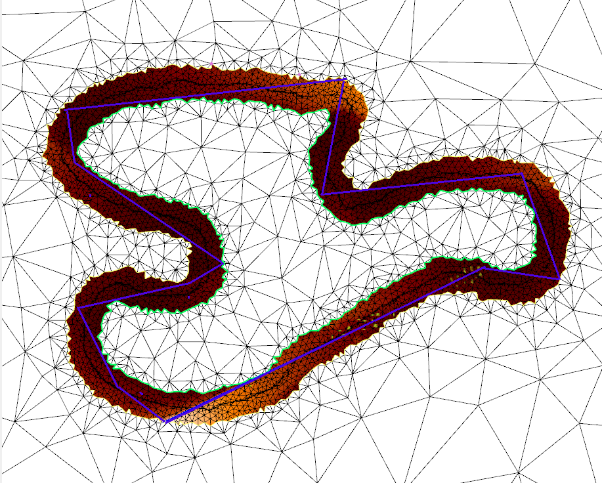
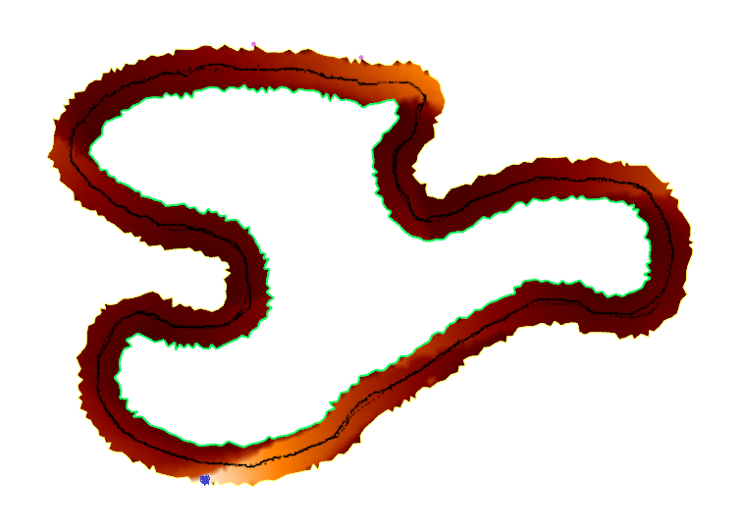
Greedy programming approach
Choose vertex of maximum visibility length as seed point.
Along visibility_length line lies choices for next candidates for vertices
Next vertex: one maximizing-
O(n) * c , c – constant time
Euclidean distance between seed and + candidate vertex
visibility length of candidate vertex

Slide 25

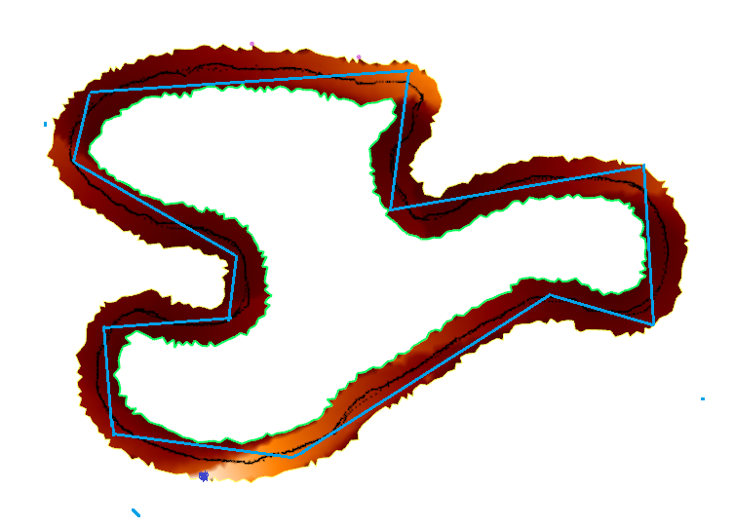
Dynamic programming approach
At i^{th} iteration:
for every point P inside tolerance volume, the end point of maximal length polyline from it of i edges, is calculated
results of (i-1)^{th} iteration are used
First Point completing its polyline is chosen as seed point.
O(n)*k k – no. of edges in final fig.

Slide 26
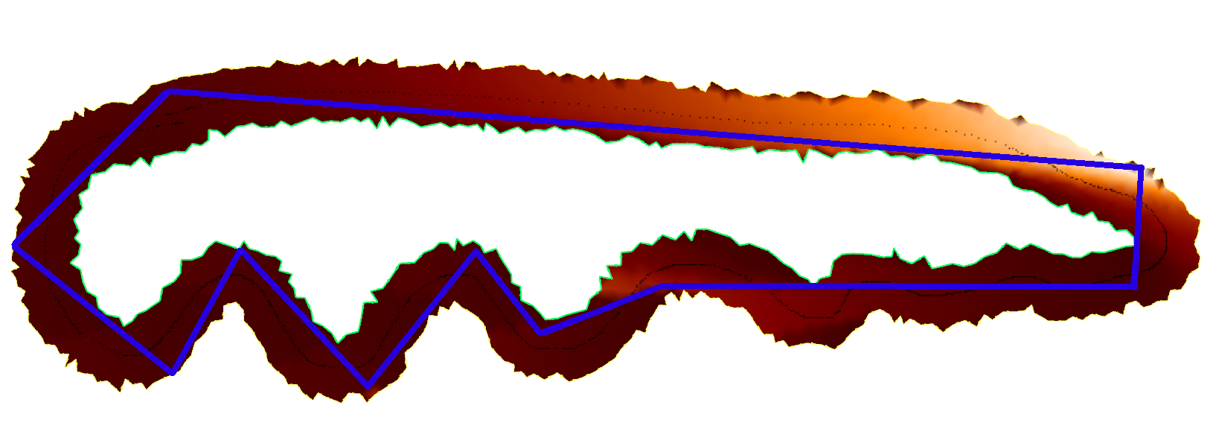
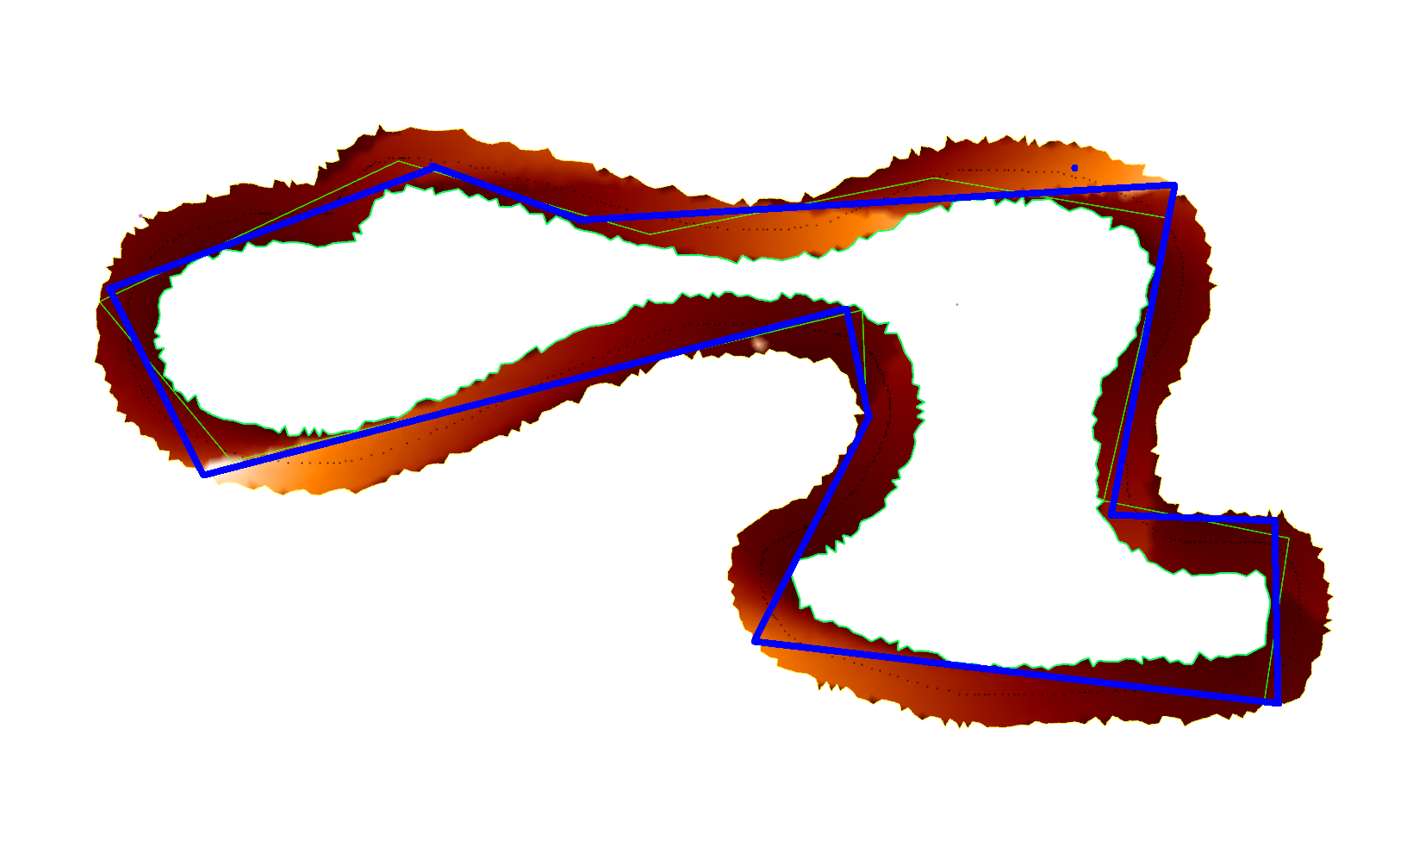
Some results

Slide 27
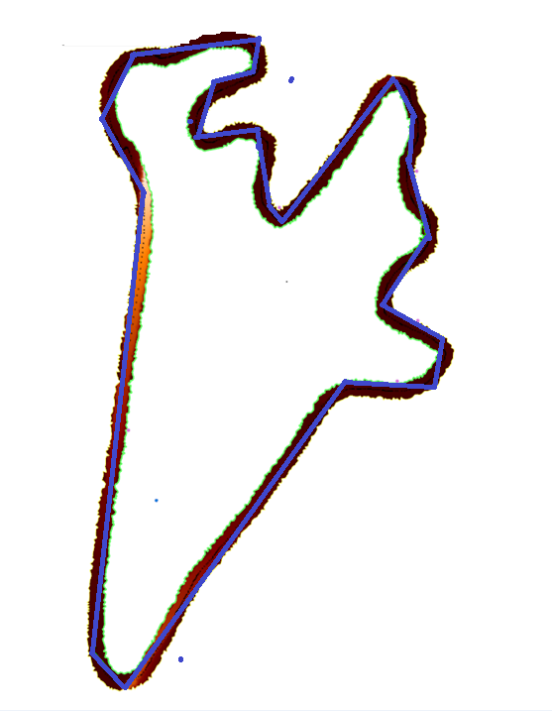
A more complex shape

Slide 28
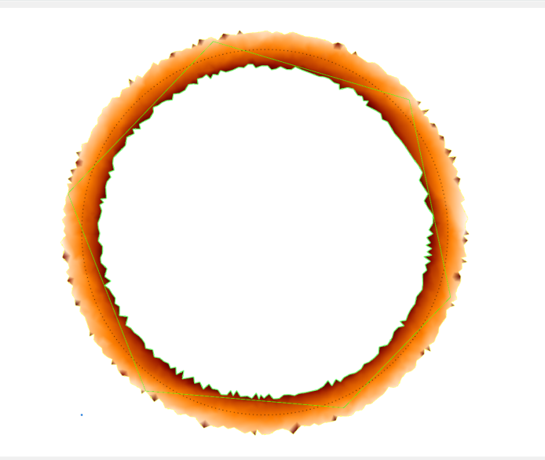
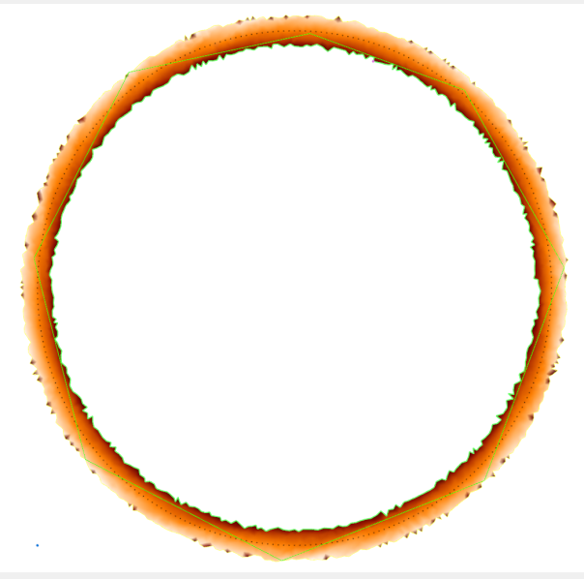
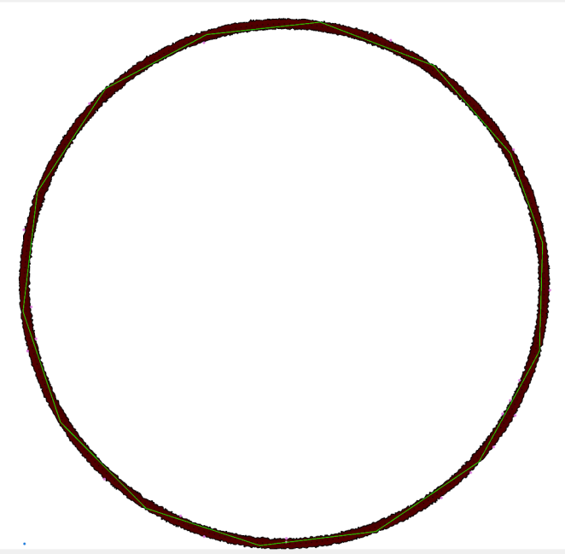
No of edges vs ε of tolerance voume
Fig a) 6 edges
Fig b) 8 edges
As thickness of tolerance volume decreases no. of edges increases
Fig c) 14 edges

Slide 29
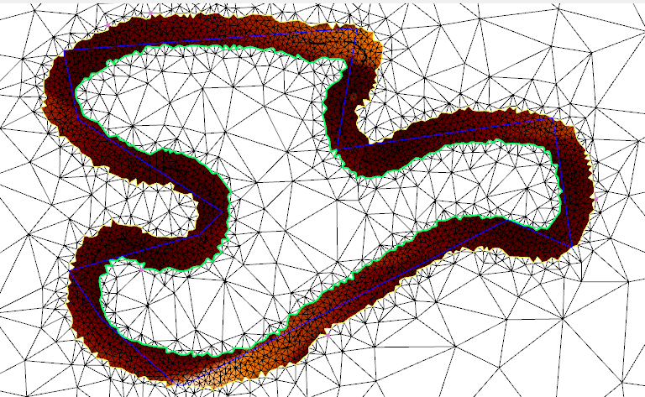
Graph for complex fig. of No. of edges vs thickness of tolerance volume(ϵ)

Slide 30
Graph of Total length of construction vs thickness of tolerance volume(ε)

Slide 32
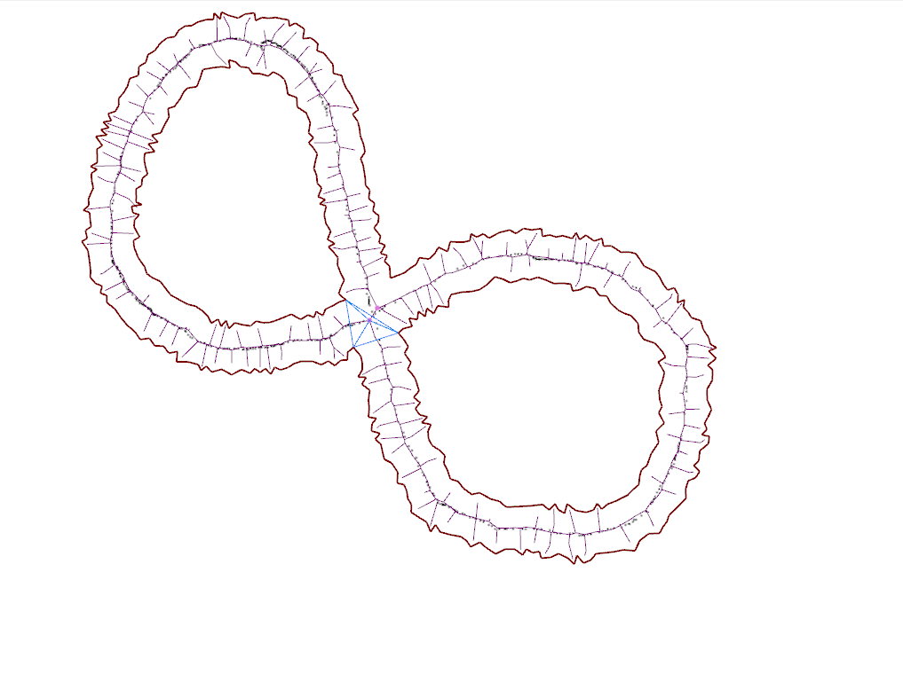
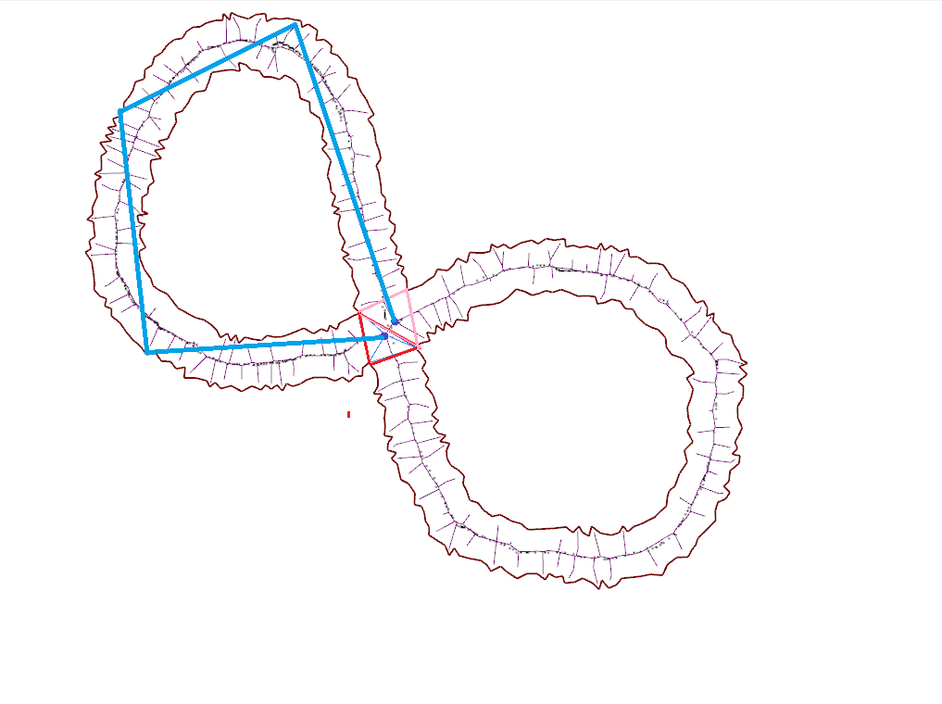
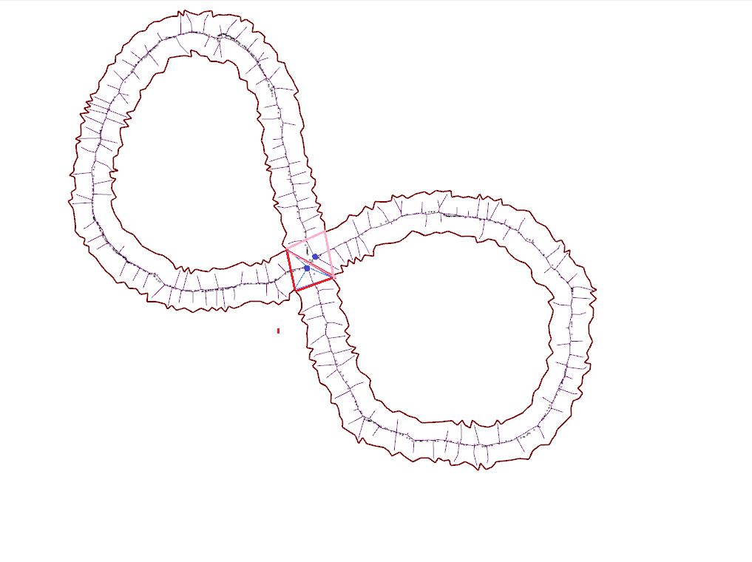
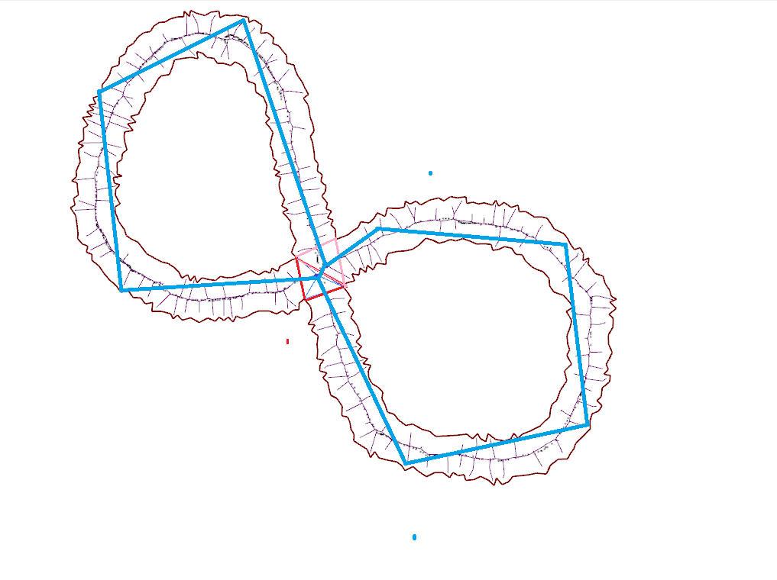
For multiple holes:
Find hubs
Find Moats
Path through each moat

Slide 33
3d extension - Direction
Rationale:
Assumption : Surface area of constructed polygon is constant (in the limit of contraction of tolerance volume)
So minimum number of facets => max. area facets to be chosen.
For each point, we have to choose group of planes (forming umbrella)such that sum of area of these planes is maximum.
Non-trivial for choice of further points, as single coverage is required.

Slide 34
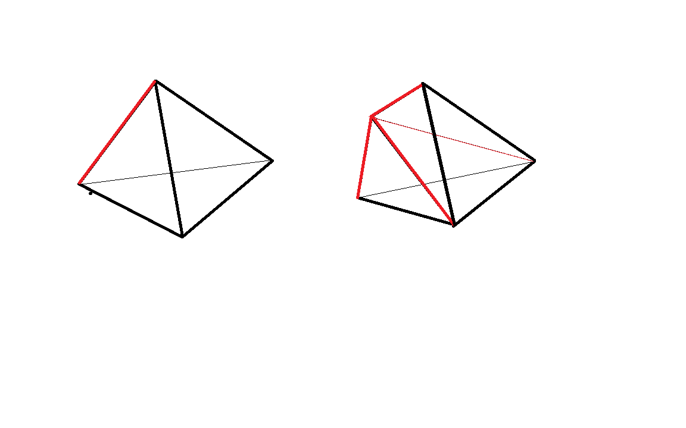
Possible direction :
(coarse to fine guided by visibility graph)
Start with tetrahedron, 4 vertices being inside tolerance volume and split it on edges ensuring that all edges and vertices are inside tolerance volume.
Further splitting is required to ensure faces are within tolerance volume
a) Red edge intersects tolerance volume
b) Splitting of red edge

Slide 35
summary

Slide 36
Visibility approach depends on local topology
Extendable to 3d
Implementation improvements are possible(since no need to find visibility polygon for each vertex)
Vis graph can be very dense or sparse depending upon thickness, dense graph can be converted to sparse graph by some notion of barriers added dynamically

